Slide 1
Data Warehouse
and Data Mining
UNIT - 3
Department: CSE (AI) Semester: 6TH

Slide 2
SYLLABUS OF UNIT 3
OLAP in the Data Warehouse: Demand for Online Analytical Processing, limitations of other analysis methods- OLAP is the answer, OLAP definitions and rules, OLAP characteristics, major features and functions, hyper cubes.
OLAP Operations: Drill-down and roll-up, slice-and-dice , pivot or rotation, OLAP models, overview of variations, the MOLAP model, the ROLAP model, the DOLAP model, ROLAP versus MOLAP, OLAP implementation considerations.
Query and Reporting, Executive Information Systems (EIS), Data Warehouse and Business Strategy.
Advanced Data warehouse Techniques: Document oriented NoSQL Databases- MangoDB, CouchDB; Graph Databases-Neo4J, Infinite Graph.

Slide 3
Imagine a big supermarket chain like Reliance or Big Bazaar.
Every day:
Thousands of customers buy products
Bills are generated
Payments are recorded
All this data is stored in a database.
Now the store manager asks questions like:
Which product sold the most last year?
In which city did sales increase the most?
How did festival season sales compare with normal months?
What is the monthly trend of profit for the last 5 years?
👉 These are analysis questions, not daily transaction questions.
To answer such questions quickly and accurately, we need OLAP.

Slide 4
Demand for Online Analytical Processing
(OLAP)
What Does “Demand” Mean Here?
As organizations grow, their data becomes:
Very large
Very complex
Spread across many years
Managers, analysts, and executives need answers fast to make decisions.
Why Traditional Databases Are Not Enough
Traditional databases (OLTP systems) are designed to:
Insert data
Update data
Delete data
They are not designed for analysis.

Slide 5
Example
A sales executive asks:
“Show me total sales of mobile phones in Haryana, Rajasthan, and Delhi from 2020 to 2024, year-wise and month-wise.”
To answer this using simple SQL:
Huge tables are scanned
Multiple joins are required
Query takes a long time
⛔ This delays decision-making.
Why OLAP Is Needed
OLAP systems:
Store summarized data
Allow fast analysis
Provide interactive results
📌 Hence, the demand for OLAP arises from the need for fast and flexible decision support.

Slide 6
Limitations of Traditional Analysis Methods
Traditional analysis methods mainly include:
Manual reports
Simple SQL queries
Spreadsheet-based analysis
OLTP-based reporting

Slide 7
Why “OLAP is the Answer”
Because OLAP Solves All These Problems
OLAP provides:
Fast query response
Multidimensional view of data
Interactive analysis
Summarized and detailed views

Slide 8
Example
Manager first asks:
“Show yearly sales.”
Then:
“Break it region-wise.”
Then:
“Now show product-wise.”
In traditional systems:
Each question = new complex query
In OLAP:
Data cube already exists
Just rotate, drill, or slice
📌 OLAP makes analysis easy, fast, and flexible.

Slide 9
What Is OLAP?
OLAP (Online Analytical Processing) is a technology used to:
Analyze large volumes of data
From multiple dimensions
At high speed
To support decision making
Standard Definition
OLAP is an approach to quickly answer multi-dimensional analytical queries on large datasets stored in a data warehouse.

Slide 10
OLAP Guidelines (Codd's Rule)
OLAP (Online Analytical Processing) is a powerful technology designed to support complex analytical queries, data exploration, and decision-making in business environments.
In 1993, Dr. E. F. Codd, the father of the relational database model, proposed 12 rules to define the features and standards that a true OLAP system must follow. These are commonly known as Codd’s OLAP Rules or OLAP Guidelines.
Note: The purpose of these guidelines is to differentiate true OLAP systems from simple query tools or data retrieval applications.

Slide 11
Codd’s 12 Rules (Guidelines) for OLAP Systems
1. Multidimensional Conceptual View
An OLAP system must provide a multidimensional view of data for effective analysis.
Key points:
Data should be organized into dimensions (e.g., Time, Product, Location).
Enables users to view data hierarchically, such as Year -> Quarter -> Month.
Facilitates operations like Drill Down, Roll Up, Slice, and Dice easily.
2. Transparency
The system should be transparent to the user, integrating seamlessly with data sources and tools.
Key points:
Users should not need to know the physical data storage details.
Data from multiple sources should appear as a single unified view.
Integration with front-end tools (Excel, dashboards, etc.) must be smooth and consistent.

Slide 12
3. Accessibility
The system should provide easy access to data across different sources.
Key points:
Should connect with multiple databases (relational, flat files, etc.).
Data retrieval must be consistent regardless of the source.
Supports extraction and integration from heterogeneous environments.
4. Consistent Reporting Performance
The performance of queries and reports must remain stable even as data grows.
Key points:
Response time should be predictable and efficient.
Query performance should not degrade with large datasets.
Pre-aggregation and indexing can be used to ensure speed.

Slide 13
5. Client/Server Architecture
OLAP systems should follow a distributed client/server model.
Key points:
Data storage and analysis should be separated for better scalability.
Multiple clients can access the OLAP server concurrently.
Enables modular design and efficient resource utilization.
6. Generic Dimensionality
All dimensions should be treated uniformly by the OLAP engine.
Key points:
System should not waste space storing empty cells.
Memory and storage must be optimized dynamically.
Enhances performance and reduces cube size drastically.

Slide 14
7. Multi-User Support
OLAP systems must support concurrent access by multiple users.
Key points:
Multiple analysts should be able to work simultaneously without conflict.
Concurrency control must ensure data consistency and isolation.
User privileges and security should be properly managed.
8. Unrestricted Cross-Dimensional Operations
The system should allow flexible calculations across dimensions.
Key points:
Users can combine measures from different dimensions freely.
Should support complex and ad-hoc calculations (e.g., profit margin by region and quarter).
No limitation on which dimensions can interact in analysis.

Slide 15
9. Intuitive Data Manipulation
Users should be able to explore and modify data intuitively.
Key points:
Drag-and-drop or point-and-click interfaces for analysis.
No need for complex query languages or programming knowledge.
Supports interactive operations like pivoting, sorting, and filtering.
10. Flexible Reporting
The system must provide dynamic and customizable reporting capabilities.
Key points:
Users can design reports as per their analytical needs.
Allows creation of summaries, comparisons, and charts on the fly.
Dimensions and measures can be rearranged easily during reporting.

Slide 16
11. Unlimited Dimensions and Aggregation Levels
The OLAP model should not restrict the number of dimensions or hierarchy levels.
Key points:
Supports multiple dimensions (e.g., Time, Product, Region, Customer).
Allows deep hierarchies (e.g., Year -> Quarter -> Month -> Week).
Enables highly detailed and comprehensive analysis.
12. Treatment of Missing Values
Missing or null data must be handled appropriately without affecting results.
Key points:
System should distinguish between zero and missing values.
Aggregations should remain accurate despite incomplete data.
Provides meaningful interpretations for null entries in reports.

Slide 18
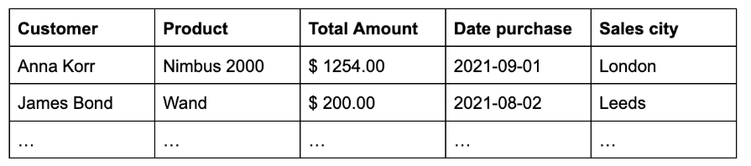
What are OLAP cubes?
OLAP cubes are a multidimensional representation of data.
To understand the multidimensional array of OLAP cubes, let us start simple - with a 2-dimensional representation we all know: Microsoft Excel.
Excel spreadsheets organize data into two dimensions: rows for each entry, and columns for attributes of that entry:

Slide 19
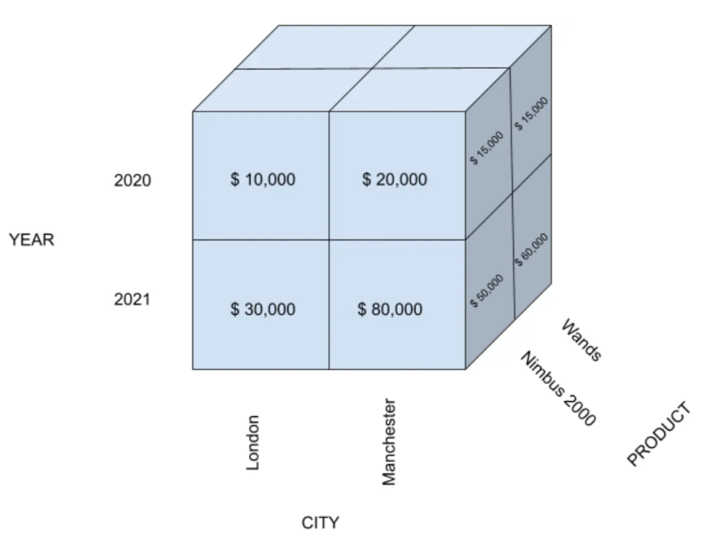
OLAP cubes go one step further and aggregate data across dimensions. For example, an OLAP cube could aggregate total sales amount across three dimensions: city, product, and time.

Slide 20
What Is a Hypercube?
A hypercube is a multi-dimensional data structure used in OLAP to store and analyze data.
A hypercube is an extension of a data cube that can store and represent data in more than three dimensions.
1 dimension → Line
2 dimensions → Table
3 dimensions → Cube
More than 3 dimensions → Hypercube

Slide 21
Real-world business data is not limited to just 3 dimensions.
For example, sales data may depend on:
Time
Region
Product
Customer
Channel
Promotion
That is 6 dimensions.
📌 A normal cube is not enough → we need a hypercube.

Slide 22
What Are OLAP Operations?
OLAP operations are a set of actions that allow users to interactively explore and analyze multidimensional data stored in OLAP cubes.
Using OLAP operations, users can:
Move from summary to detail
Compare data from different angles
Focus on specific parts of data
Change the way data is viewed
The most important OLAP operations are:
Drill-down
Roll-up
Slice
Dice
Pivot (Rotation)

Slide 23
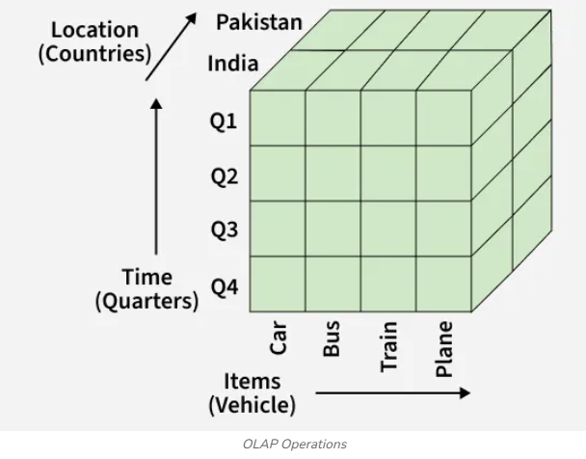
It is based on a multidimensional data model, where data is represented in the form of cubes, also known as hyper-cubes. Each cube consists of dimensions (e.g., Location, Time, Product) and measures (e.g., Sales, Profit).

Slide 24
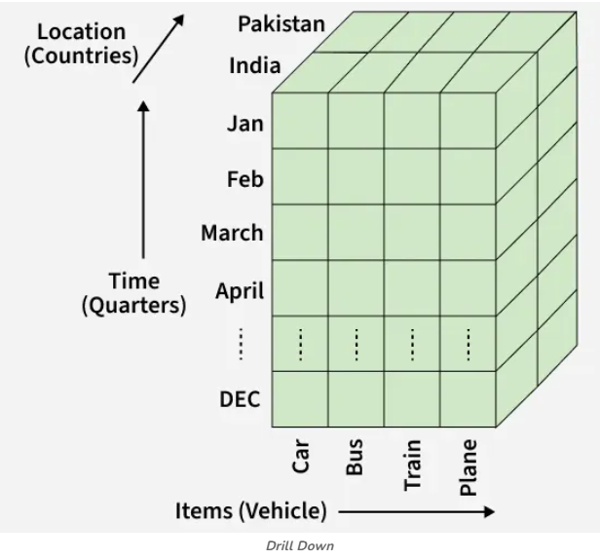
1. Drill Down
The Drill Down operation provides a more detailed view of the data.
It moves from a summary level to a lower level in the concept hierarchy (for example, from Year -> Quarter -> Month).
How it works: Moving down in the hierarchy & adding new dimensions for more granularity.
Example: Viewing sales data for 2024 -> Q1 -> January instead of only yearly totals.

Slide 25

2. Roll Up
The Roll Up operation is the opposite of Drill Down.
It aggregates or summarizes data to provide a higher-level overview.
How it works: Climbing up in the concept hierarchy & reducing the number of dimensions.
Example: Aggregating sales data from City -> Country or from Month -> Quarter.

Slide 26
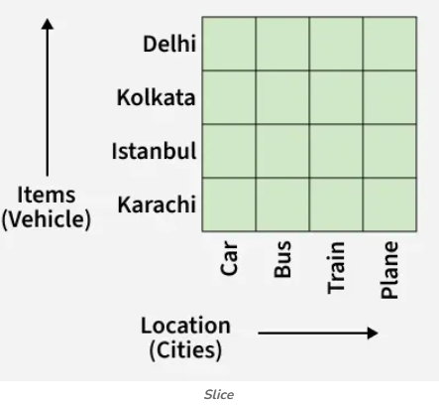
3. Slice
The Slice operation selects a single dimension from the cube, creating a new sub-cube with reduced dimensionality.
It helps focus on a specific data slice for analysis.
Example: Selecting Time = "Q1" to analyze sales across all products and regions for the first quarter.

Slide 27
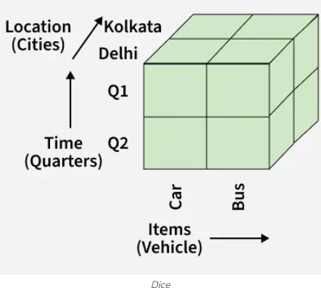
4. Dice
The Dice operation selects data from the cube by applying filters on two or more dimensions to form a sub-cube.
This results in a smaller cube focused on these specific dimensions.
Example: Selecting: Location = "Delhi" or "Kolkata", Time = "Q1" or "Q2" & Item = "Car" or "Bus"

Slide 28
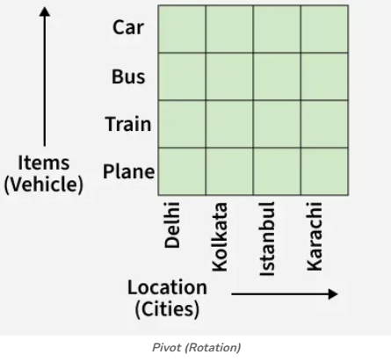
5. Pivot (Rotation)
The Pivot operation (also known as Rotation) reorients the cube to provide a different view of the data.
It helps users visualize data from different perspectives by rotating rows and columns.
Example: Swapping the Time and Location axes to compare sales by quarter across different regions.

Slide 30
A retail company stores its sales data in a data warehouse with the following dimensions:
Time: Year → Quarter
Region: North, South
Product: Mobile, Laptop
Measure: Sales (in ₹ lakhs)
The sales data for the year 2023 is shown below:
Quarter | Region | Product | Sales
Q1 | North | Mobile | 120
Q1 | North | Laptop | 180
Q1 | South | Mobile | 100
Q1 | South | Laptop | 150
Q2 | North | Mobile | 140
Q2 | North | Laptop | 200
Q2 | South | Mobile | 110
Q2 | South | Laptop | 160

Slide 31
Roll-Up Operation:
Perform a roll-up operation to calculate the total yearly sales for each region.
Roll-up here means going from Quarter level → Year level by summing sales for each region across all products and quarters.
North (Yearly total)
North total = 120 + 180 + 140 + 200 = (120 + 180) + (140 + 200) = 300 + 340 = 640 ₹ lakhs
South (Yearly total)
South total = 100 + 150 + 110 + 160 = (100 + 150) + (110 + 160) = 250 + 270 = 520 ₹ lakhs
Result (Roll-Up Output)
Region | Total Sales in 2023 (₹ lakhs)
North | 640
South | 520

Slide 32
Drill-Down Operation:
Starting from region-wise yearly sales, drill down to show quarter-wise sales for the North region.
Drill-down means moving from summary → detail.
We already have North yearly total (640). Now we break it into Q1 and Q2.
North Q1 total
North Q1 = Mobile 120 + Laptop 180 = 300 ₹ lakhs
North Q2 total
North Q2 = Mobile 140 + Laptop 200 = 340 ₹ lakhs
Drill-down Output (North, Quarter-wise)
Region | Quarter | Sales (₹ lakhs)
North | Q1 | 300
North | Q2 | 340

Slide 33
Slice Operation:
Apply a slice operation for Product = Mobile and show the resulting data.
Slice means fixing one dimension value.
Here we fix Product = Mobile and keep other dimensions (Quarter, Region).
Slice Output (Only Mobile rows)
Quarter | Region | Product | Sales (₹ lakhs)
Q1 | North | Mobile | 120
Q1 | South | Mobile | 100
Q2 | North | Mobile | 140
Q2 | South | Mobile | 110

Slide 34
Dice Operation:
Perform a dice operation for the following conditions:
Region = North
Product = Laptop
Quarter = Q1 and Q2
Dice means selecting a subset using multiple conditions (more than one dimension).
Conditions:
Region = North
Product = Laptop
Quarter ∈ {Q1, Q2}
Dice Output
Quarter | Region | Product | Sales (₹ lakhs)
Q1 | North | Laptop | 180
Q2 | North | Laptop | 200

Slide 35
Pivot Operation:
Apply a pivot operation to display products as columns and regions as rows, showing total sales.
Pivot means changing the data orientation (rows/columns), not changing values.
First compute totals per (Region, Product) across Q1+Q2:
North totals
North Mobile = 120 + 140 = 260
North Laptop = 180 + 200 = 380
South totals
South Mobile = 100 + 110 = 210
South Laptop = 150 + 160 = 310
Pivot Output (Region as rows, Product as columns)
Region | Mobile (₹ lakhs) | Laptop (₹ lakhs)
North | 260 | 380
South | 210 | 310

Slide 37
OLAP Servers and Its Types

Slide 38
What is an OLAP Server?
An OLAP server is a specialized system that performs fast, multidimensional analysis on data stored in a data warehouse.
It sits between the data warehouse and BI tools.
It creates and manages data cubes/hypercubes.
It executes OLAP operations: drill-down, roll-up, slice, dice, pivot.

Slide 39
Why Do We Need OLAP Servers?
Traditional databases are optimized for transactions (OLTP), not analysis.
Analytical queries are complex and slow on raw transactional data.
OLAP servers provide fast response for decision-making queries.
They support interactive and multidimensional analysis.

Slide 40
OLAP Server in DW Architecture
OLTP Systems → ETL → Data Warehouse → OLAP Server → BI/OLAP Tools
OLAP server acts as middleware for analytical processing.
Users interact via dashboards; server handles computation.

Slide 41
Types of OLAP Servers
MOLAP (Multidimensional OLAP)
ROLAP (Relational OLAP)
HOLAP (Hybrid OLAP)

Slide 42
MOLAP (Multidimensional OLAP)
Stores data in multidimensional cube structures.
Aggregations are pre-computed and stored.
Very fast query response for analytical queries.
Best for moderate-sized, stable datasets.

Slide 43
MOLAP: Example, Advantages & Limitations
Example: Retail sales cube with Time, Region, Product dimensions.
Advantages: Extremely fast, excellent multidimensional analysis.
Limitations: High storage cost, limited scalability, cube rebuild time.

Slide 44
ROLAP (Relational OLAP)
Data remains in relational tables (star/snowflake schema).
OLAP operations are translated into SQL queries.
Scales well for very large datasets.
Uses existing RDBMS technology.

Slide 45
ROLAP: Example, Advantages & Limitations
Example: Telecom call records analyzed via SQL aggregations.
Advantages: High scalability, storage efficient, flexible schema.
Limitations: Slower than MOLAP, complex SQL, DB tuning required.

Slide 46
HOLAP (Hybrid OLAP)
Combines MOLAP and ROLAP approaches.
Summary data stored in cubes; detailed data in relational tables.
Balances speed and scalability.
Used in large enterprise BI systems.

Slide 47
HOLAP: Example, Advantages & Limitations
Example: Retail chain dashboards (cubes) with bill-level drill-down (tables).
Advantages: Fast summaries, scalable details, efficient storage.
Limitations: More complex architecture, higher cost, cube processing.

Slide 48
Comparison of OLAP Server Types
MOLAP: Cube storage, very fast, limited scalability.
ROLAP: Table storage, highly scalable, slower queries.
HOLAP: Hybrid storage, balanced performance and scalability.

Slide 49
When to Use Which OLAP Server?
Use MOLAP for fast dashboards with moderate data size.
Use ROLAP for very large datasets requiring scalability.
Use HOLAP when both fast summaries and detailed drill-down are needed.

Slide 50
Summary
OLAP servers enable fast, multidimensional analysis for decision support.
Three main types: MOLAP, ROLAP, HOLAP.
Choice depends on data size, performance needs, and scalability.

